Slide 1
Inventory Management System
August Davis, Christian Hansen, David Erickson

Slide 2
Goals of the project
Ability to scan barcodes of inventory from a cellphone camera
Organize inventory information in a format that will allow for easy viewing, editing and auditing
Have an easy to use interface
Comprehensive documentation for future developers of the project

Slide 3
Interface
Goals
Current State
Prioritizing Android compatibility using a web-based application.
Easy access to features (login, stored inventory, scanner features)
Compliant with university style guidelines
We were working on a test on mobile
All features are easily accessible from the home page
Interface complies with most basic und style guidelines

Slide 4
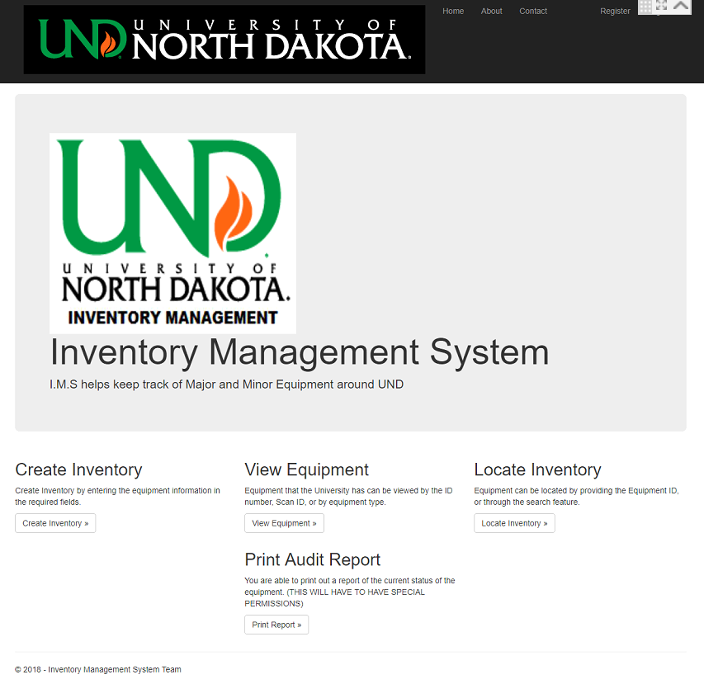

Slide 5
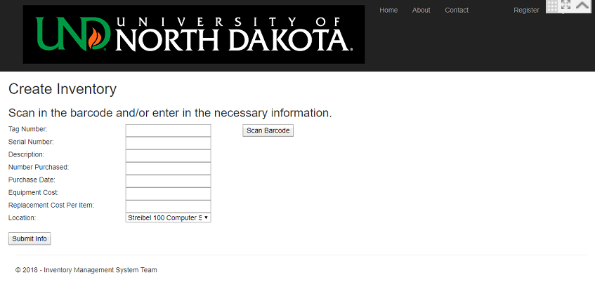

Slide 6
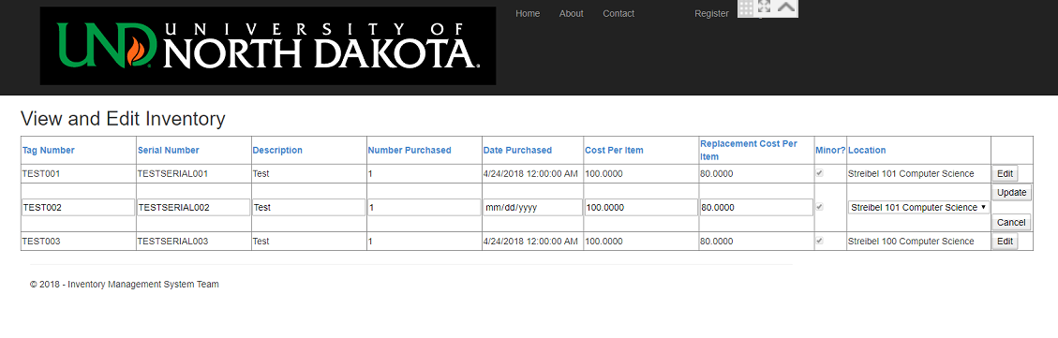

Slide 7
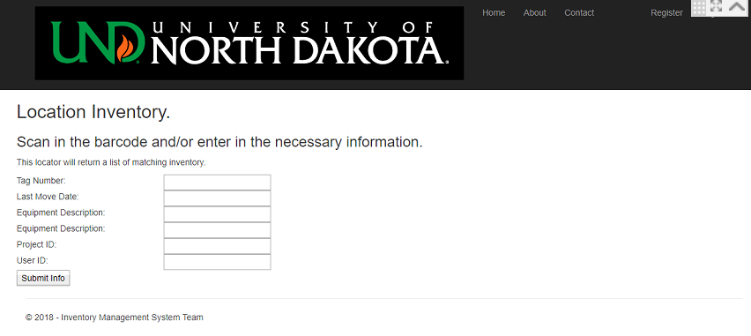

Slide 8
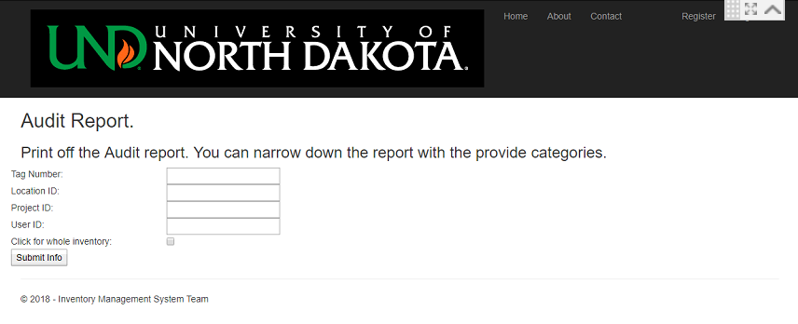

Slide 9
Storage
Goals
Current State
Store all relevant information for inventory items
Allow for easy access and manipulation of stored items
Microsoft SQL Server is used for storage
Tables and server are set up
Website successfully connects to the server when hosted locally, But is having trouble with editing

Slide 10
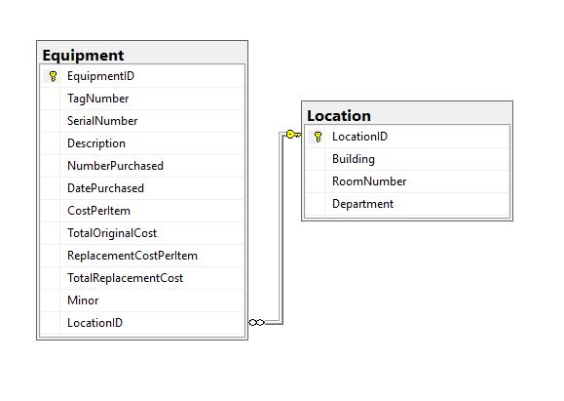
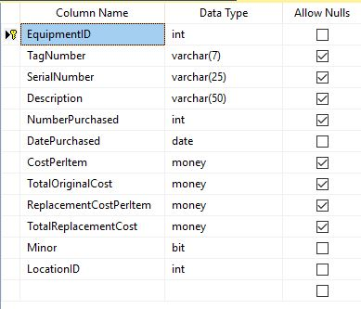

Slide 11
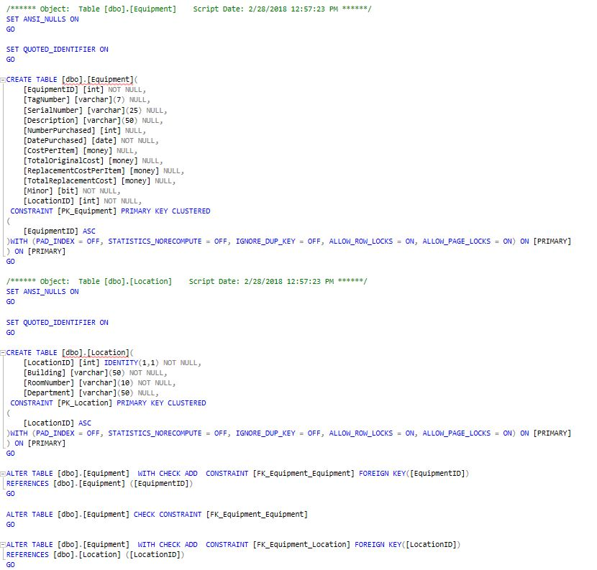

Slide 12
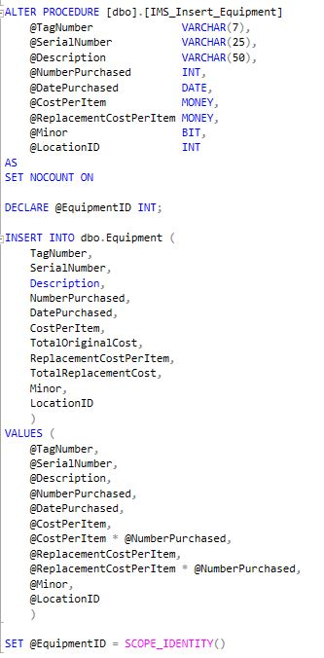

Slide 13
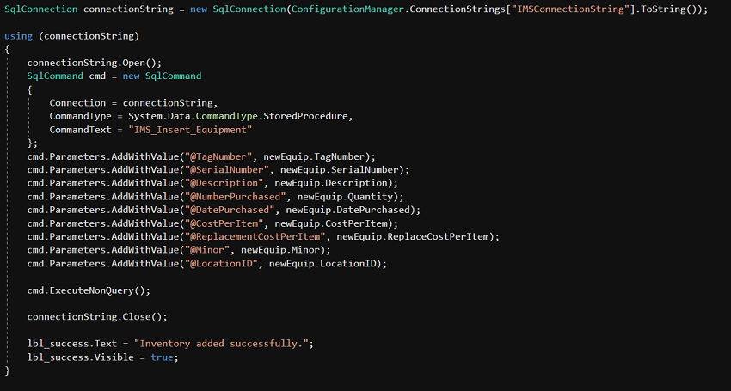

Slide 14
Scanner
Goals
Current State
Scanning the barcodes found on department inventory from a phone camera
Secondary goal: scanning barcodes from a PC
On android scanning is handled by a call to the external app “Zxing Barcode Scanner”
On PC scanning is handled by a USB hand scanner
No scanning available on non android phones

Slide 15
Possible future work
Setting up a hosting server
Further optimizing the interface for mobile
Adjusting the interface to follow more UND standards
Converting the data from the old system to this one
Adding a scanning option for IOS
Adding updating and deleting of locations
Creating audit reports with Report Wizard tool

Slide 16
Finished. Questions?

